Slide 1
Grid Network Experiments 1
封钰震
2021/8/8

Slide 2
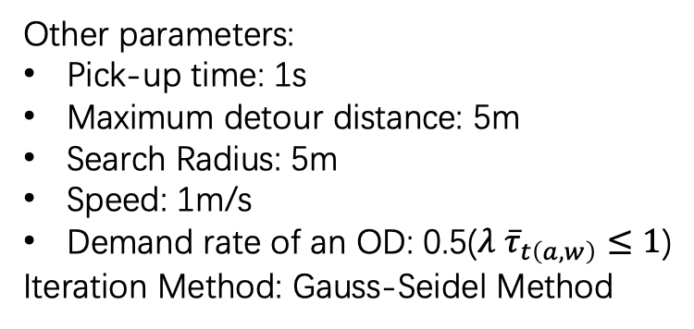
Time consumed of each step
Network | OD | Taker | Match | Iteration | Step 0 / s | Step 1 / s
30*30 | 300 | 5056 | 32772 | 29 | 0.488 | 0.453
180*180 | 2000 | 191956 | 148530 | 20 | 108.342 | 4.285
180*180 | 1e4 | 9.5e5 | 3.6e6 | 25 | 2692.946 | 53.341
Other parameters:
Pick-up time: 1s
Maximum detour distance: 5m
Search Radius: 5m
Speed: 1m/s
Demand rate of an OD: 0.5($λ {\overline{τ}}_{t\left(a,w\right)}≤1$)
Iteration Method: Gauss-Seidel Method

Slide 4
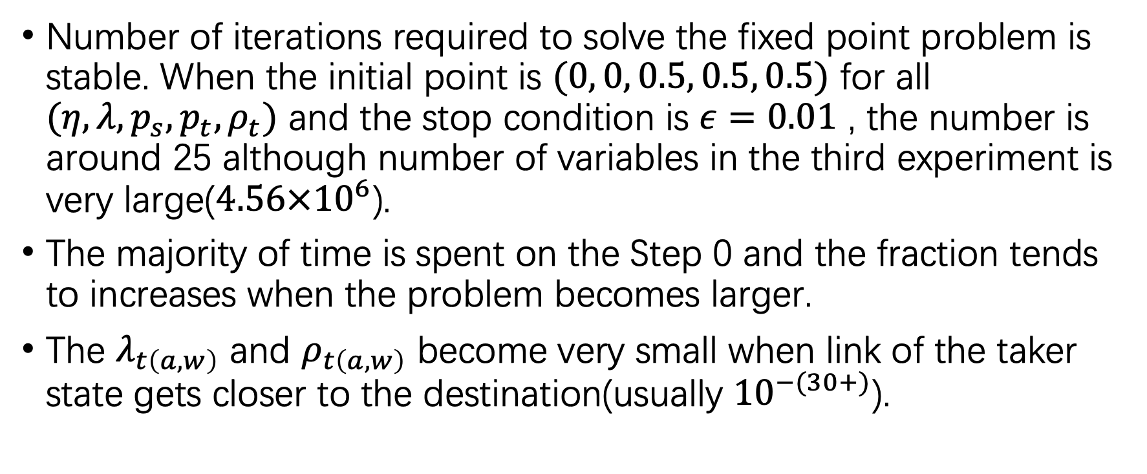
Experiment phenomena
Number of iterations required to solve the fixed point problem is stable. When the initial point is $(0, 0, 0.5, 0.5, 0.5)$ for all $(η, λ, p_{s}, p_{t}, ρ_{t})$ and the stop condition is $ε=0.01$ , the number is around 25 although number of variables in the third experiment is very large($4.56×{10}^{6}$).
The majority of time is spent on the Step 0 and the fraction tends to increases when the problem becomes larger.
The $λ_{t\left(a,w\right)}$ and $ρ_{t\left(a,w\right)}$ become very small when link of the taker state gets closer to the destination(usually ${10}^{−(30+)}$).

